Slide 1
Capital Bikeshare Analysis Report

Slide 2
Part 1 Research Introduction
Part 2 About Dataset
Agenda
Part 3 exploratory data analysis
Analysis
Part 4 Features Selecting
Part 5 Model tuning
Part 6 Conclusion and future
research direction

Slide 3
1
Research Introduction

Slide 4
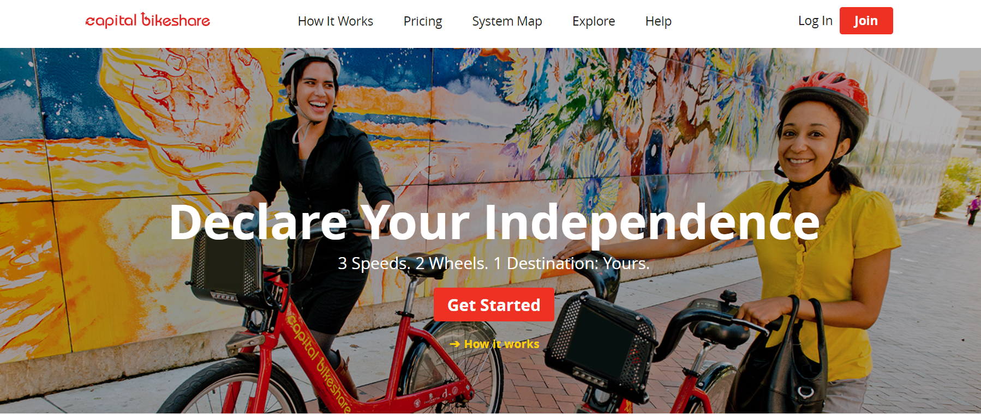
Introduction
Until now, Capital Bikeshare has been operating for over 10 years. It provides public bicycle for people to satisfy different purposes (Last mile, bike tour, exercise, etc.) Because of the development of the city, Capital Bikeshare needs to consider expanding service locations and increasing the number of bikes. Thus, this analysis will build up a bike usage prediction model (based on daily) to provide data insight for The Capital Bikeshare.

Slide 5
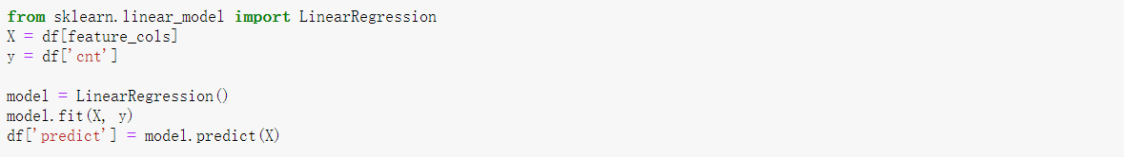
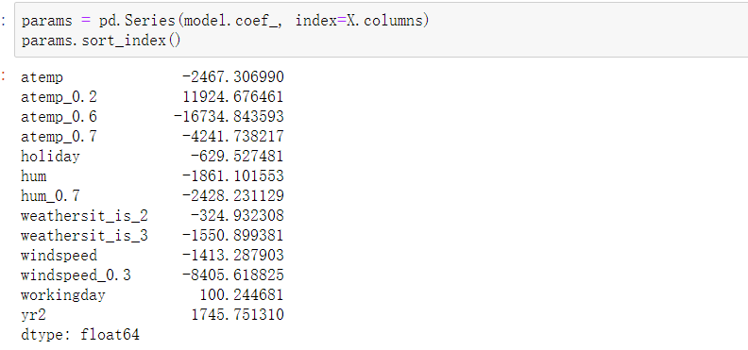
Introduction
Considering that there is only 731 records of data and our purpose is to predict the number of bikes usage, this research implements Linear Regression model in data analysis
Here are details about
the linear regression model
Parameters. In our model, atemp, holiday, hum, weathersit, windspeed, workingday, and yr would impact the prediction result
Notes:
Cap floor data preprocessing

Slide 6
2
About
The Dataset

Slide 7
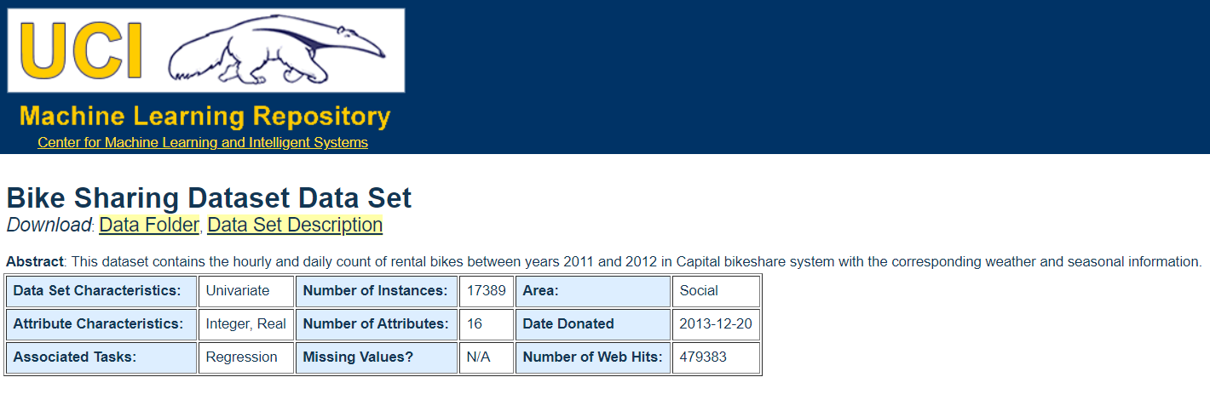
About the dataset
the dataset is download from UCI Machine Learning Repository (https://archive.ics.uci.edu/ml/datasets/bike+sharing+dataset). It records 2011,and 2012 these two years’ data.
And the original data comes from Capital Bikeshare Official website(http://capitalbikeshare.com/system-data)

Slide 8
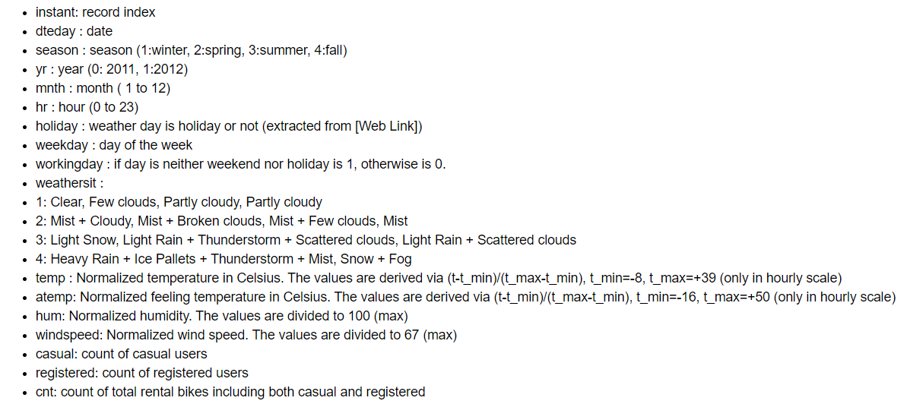
About the Dataset
Attributes in these dataset:

Slide 9
3
exploratory data analysis
Analysis

Slide 10
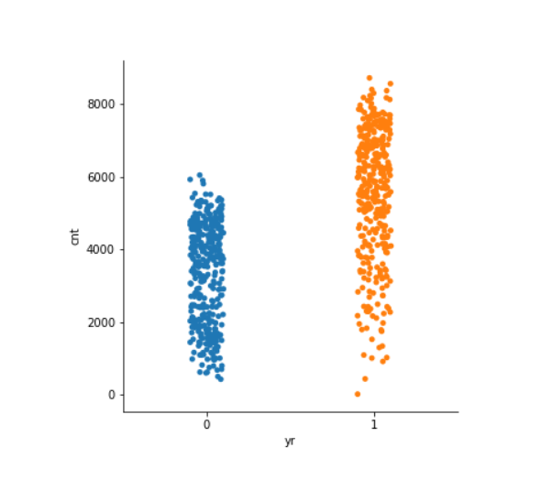
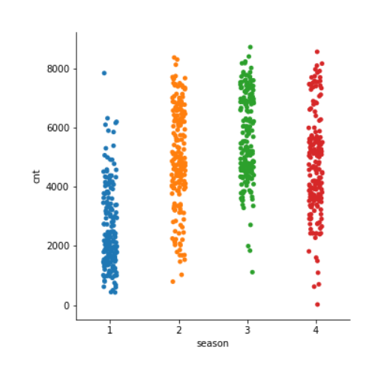
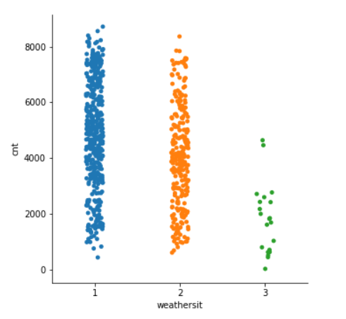
EDA Analysis
For categorical variables in this dataset, we found that:
1. Comparing with the previous year (2011), the amount of bike usage is increasing
2. People prefer riding bikes in Autumn, but not likely to rent bike in Spring
2. If the weather is not bad (no rain, no snow) People are preferring riding bikes

Slide 11
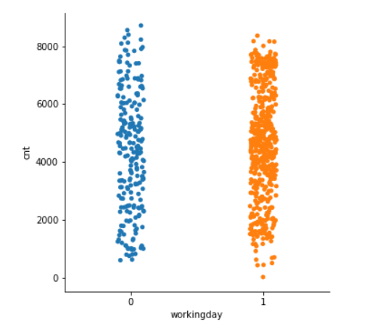
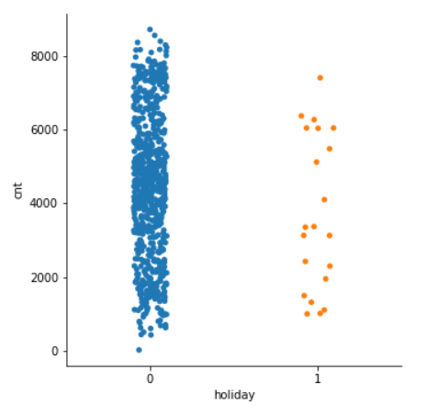
EDA Analysis
For the categorical variables in this dataset, we found that:
4. Whether is a working day won’t impact the daily amount of bike usages. However, if the day is a holiday, lots of people will stop choosing to ride bike

Slide 12
EDA Analysis
For continuous variables in this dataset, we found that they do have relationship with the amount of total users (‘cnt’) So, we make a chart to show it:
Variable Name | Correlation with ‘cnt’ | knot point
Temp | Positive, but will turn negative when reaches at a certain point | 0.6, 0.7
Atemp | Positive, but will turn negative when reaches at a certain point | 0.6, 0.7
Hum | positive, but will turn negative when reaches at a certain point | 0.61
windspeed | Negative

Slide 13
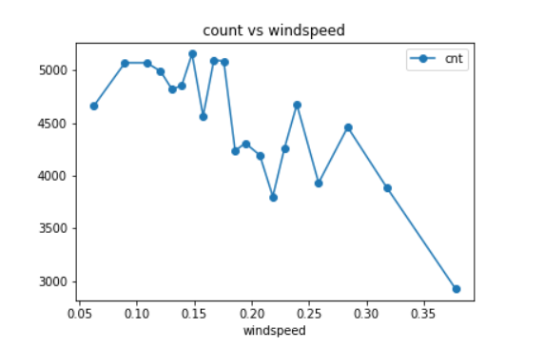
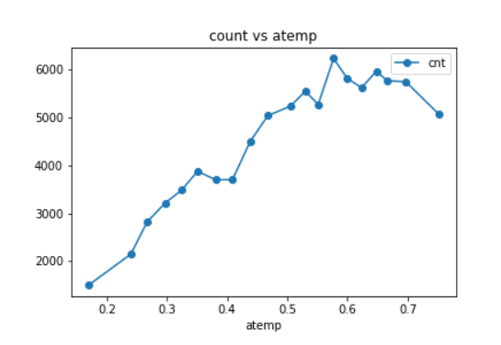
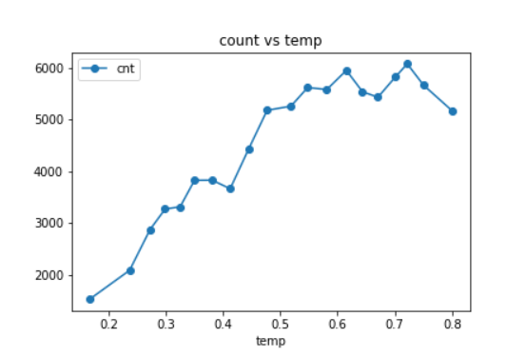
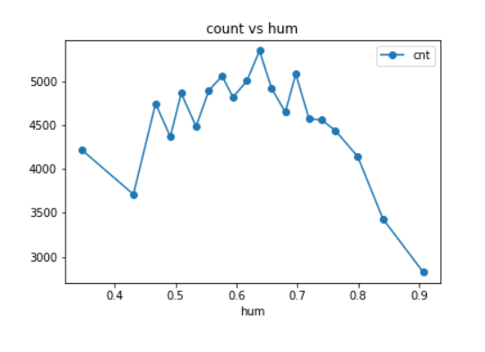
EDA Analysis
Here are graphics from above charts:

Slide 14
Hypothesis
The usage amount of sharing bikes relates to seasons (Because different seasons have different average temperature).
The usage amount of sharing bikes relates to weather factors (humidity, Windspeed, etc.)
The usage amount of sharing bikes may be determined by whether a day is holiday.

Slide 15
4
Feature Selection

Slide 16
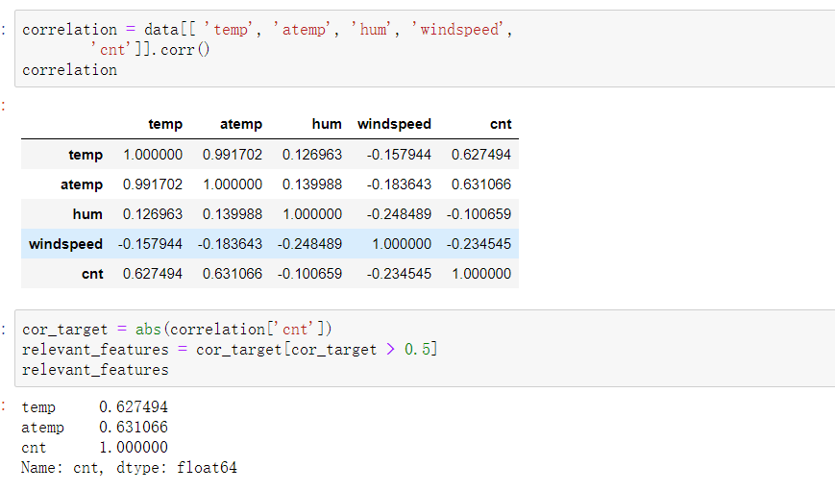
Features Selection
Step 1: Confirm the coefficient between each features (continuous)

Slide 17
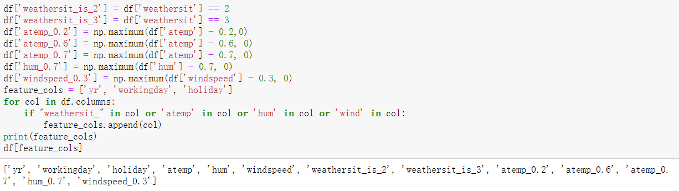
Features Selection
Step 2: Use Spline term to process features which doesn’t have strong linear relationship with the dependent variable

Slide 18
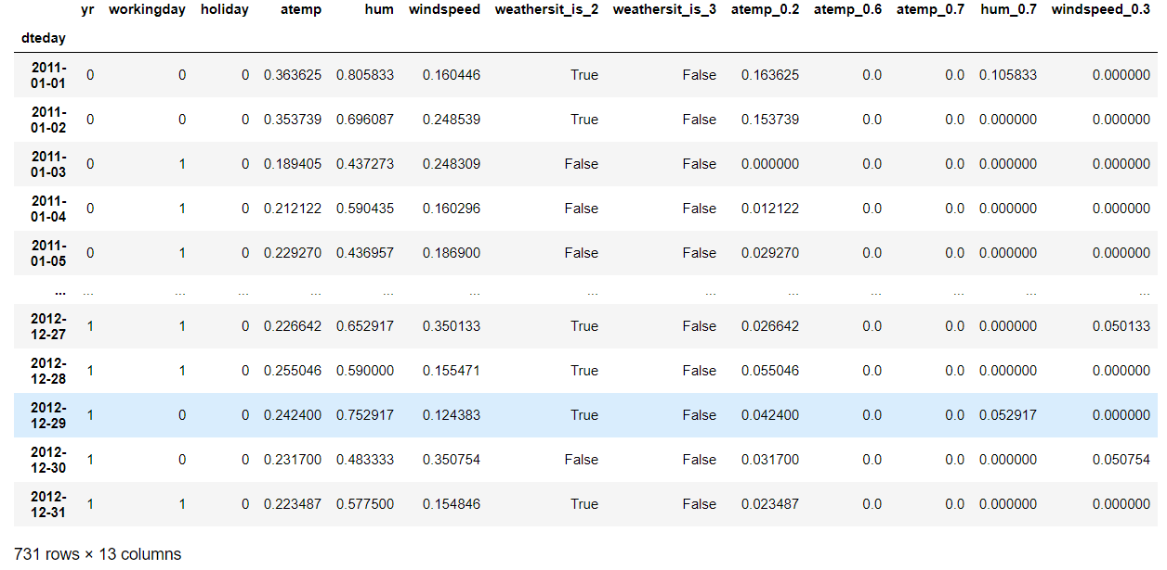
Features Selection
Step 3: Confirm the features and produce new datasets, ready to build the model

Slide 19
5
Model Tuning
Notes:
Add code before this slice

Slide 20
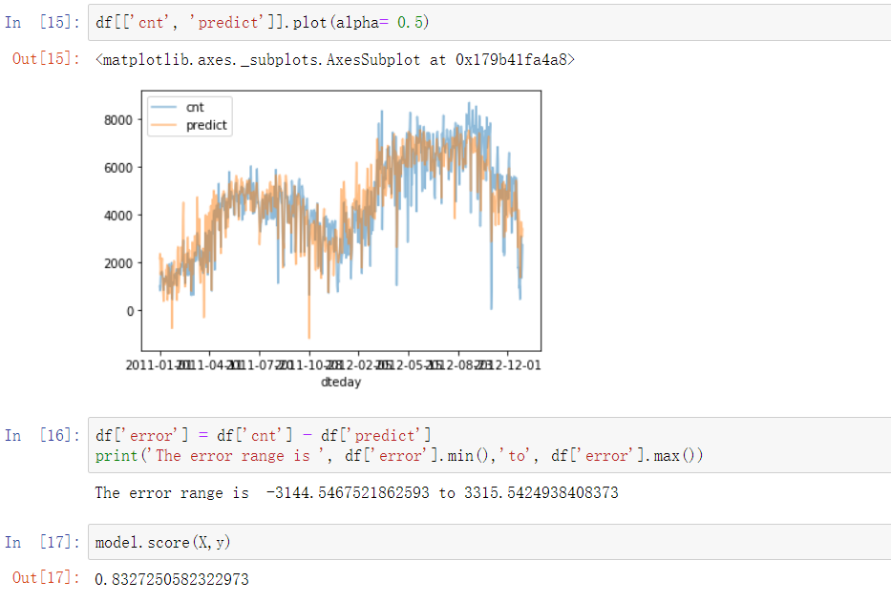
Tuning
Before Tuning

Slide 21
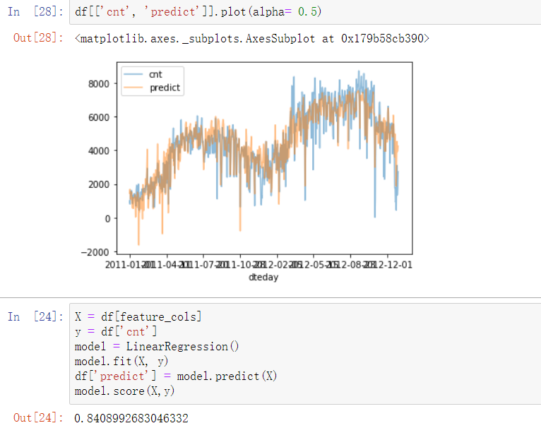
Tuning
After Tuning

Slide 22
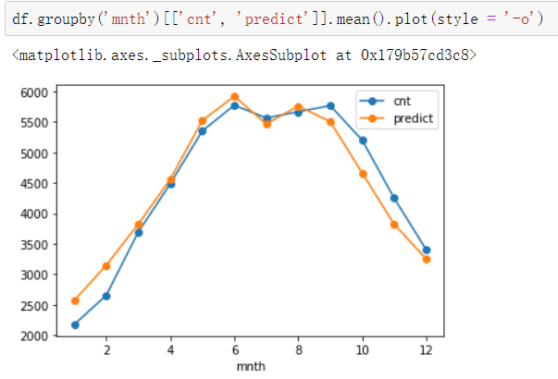
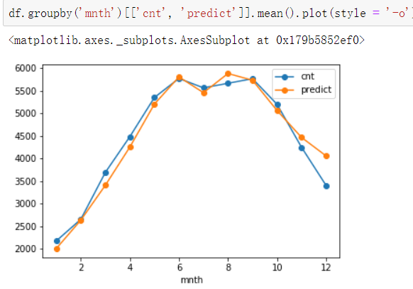
Tuning
The concept of tuning:
When we plot the usage graphic, we found that the feature ‘yr’ could be modified more details since there is the “month” feature in it, Therefore ,we redefined the yr columns

Slide 23
6
Conclusion

Slide 24
Future research direction
According to the analysis, Capital Bikeshare needs to increase more bikes
Capital Bikeshare could distribute bikes based on the next day’s weather
When comes to holiday, Capital Bike could retrieve some bikes to prevent unnecessary damage

Slide 25
Conclusion
Records more details information about the bike usages, such as length of use, rental distance, popular rent station, etc.
Collect daily news and confirm any special events during the recording period
Collect Capital Bikeshares daily distributing bikes data

